Slide 1

SRS on vehicle tracking system
Submitted by : Submitted to :
25.Deepak Kumar Dr. Amanpreet Singh
26.Sonu Kumar
27.Vikas Gangwar
28.Neekhilesh Mitra

Slide 2

INTRODUCTION:
Vehicle tracking systems provide real-time monitoring and management of vehicle locations and status. This technology plays a vital role across industries, offering enhanced security, improved efficiency, and reduced operational costs. The market is projected to reach $52.9B by 2030, reflecting a CAGR of 9.4%. Examples include fleet management,
SCOPE:
stolen vehicle recovery, and delivery optimization, showcasing the widespread applicability of these systems.

Slide 3

SYSTEM ARCHITECTURE AND KEY FUNCTIONALITIES:
Performance:
System response time < 2 seconds.
Security:
Data encryption (AES-256), user authentication
Reliability:
99.99% uptime, automated backups.
Scalability: Support 10,000+ vehicles.
Non-functional requirements are critical for the system's overall quality and user satisfaction. High performance ensures quick response times. Robust security measures protect sensitive data. High reliability guarantees consistent availability, and scalability ensures the system can handle a growing number of vehicles and users. Usability is achieved through intuitive interfaces and multilingual support.

Slide 4

Functional Requirements: Core System Capabilities
1.Real-time Location Tracking:
GPS accuracy within 10 feet, update frequency every 30 seconds.
2. Geofencing:Create unlimited geofences, trigger alerts on entry/exit.
3. Reporting:Generate daily, weekly, monthly reports on vehicle usage.
4. Alerting:Speeding, unauthorized usage, maintenance reminders (SMS & email).
The functional requirements define the core capabilities of the vehicle tracking system. Precise real-time location tracking is crucial, with frequent updates. Geofencing allows for the creation of virtual boundaries, triggering alerts when vehicles enter or exit these areas. Comprehensive reporting provides insights into vehicle usage patterns, and an alerting system notifies users of critical events.

Slide 5

Non-Functional Requirements: Ensuring System Quality
1.Performance:System response time < 2 seconds.
2. Security:Data encryption (AES-256), user authentication.
3. Reliability:99.99% uptime, automated backups.
Scalability
Support 10,000+ vehicles.
Non-functional requirements are critical for the system's overall quality and user satisfaction. High performance ensures quick response times. Robust security measures protect sensitive data. High reliability guarantees consistent availability, and scalability ensures the system can handle a growing number of vehicles and users. Usability is achieved through intuitive interfaces and multilingual support.

Slide 6

External Interface Requirements: Hardware and Software Integrations:
GPS Module
U-blox NEO-M8N, NMEA-0183 protocol.
Cellular Communication
GSM/GPRS/4G LTE, TCP/IP protocol.
Mapping API
Google Maps, Leaflet, OpenStreetMap.
External interface requirements define how the vehicle tracking system interacts with other components. The GPS module provides location data. Cellular communication enables data transmission. Mapping APIs are used for visualizing vehicle locations. The database stores system data, and mobile apps provide user access. API integrations allow for seamless integration with other services.

Slide 7

System Features: Real-Time Tracking & Mapping
Real-Time Vehicle Location
Display current location on a map with selectable views.
Historical Route Playback
Reconstruct vehicle routes with timestamped data.
Geofence Visualization
Overlay geofences on the map and track entry/exit events.
Traffic Conditions
Integrate real-time traffic data for route optimization.

Slide 8
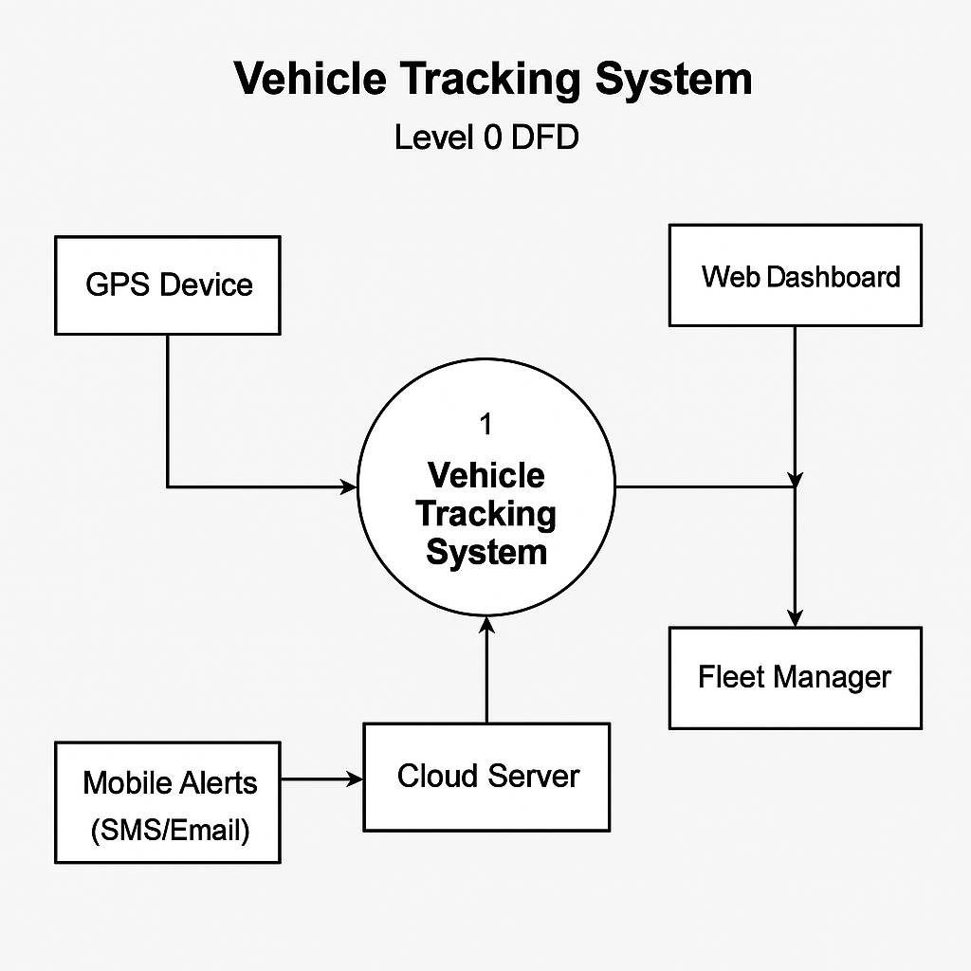
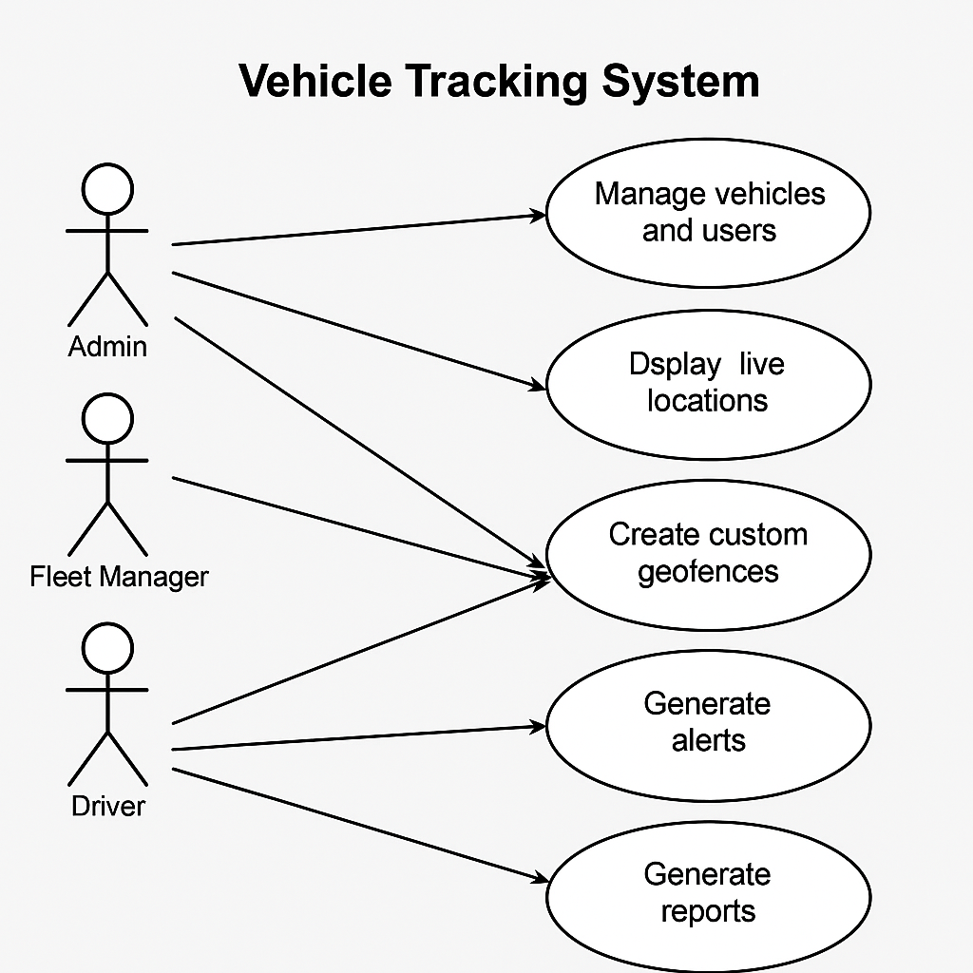
DATA FRAME DIAGRAM FOR 0 LEVEL

Slide 9
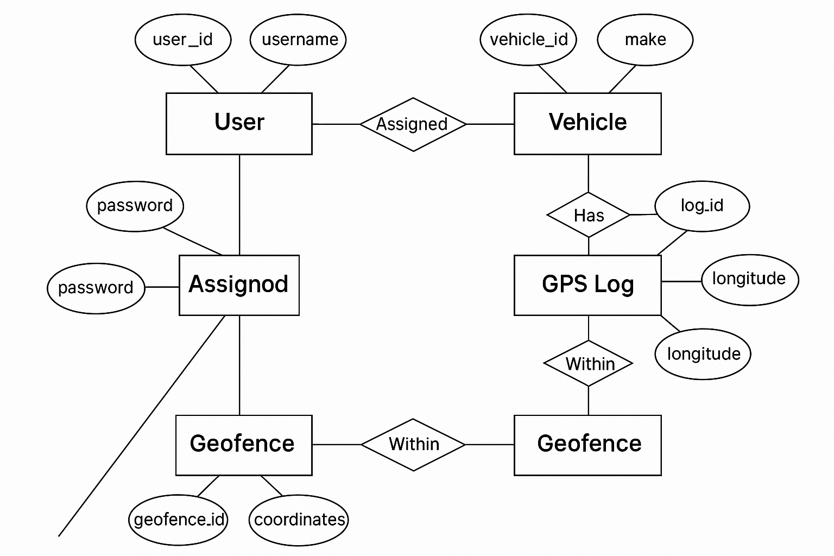
Data Frame Diagram: Data Structure and Flow
ER DIAGRAM

Slide 10
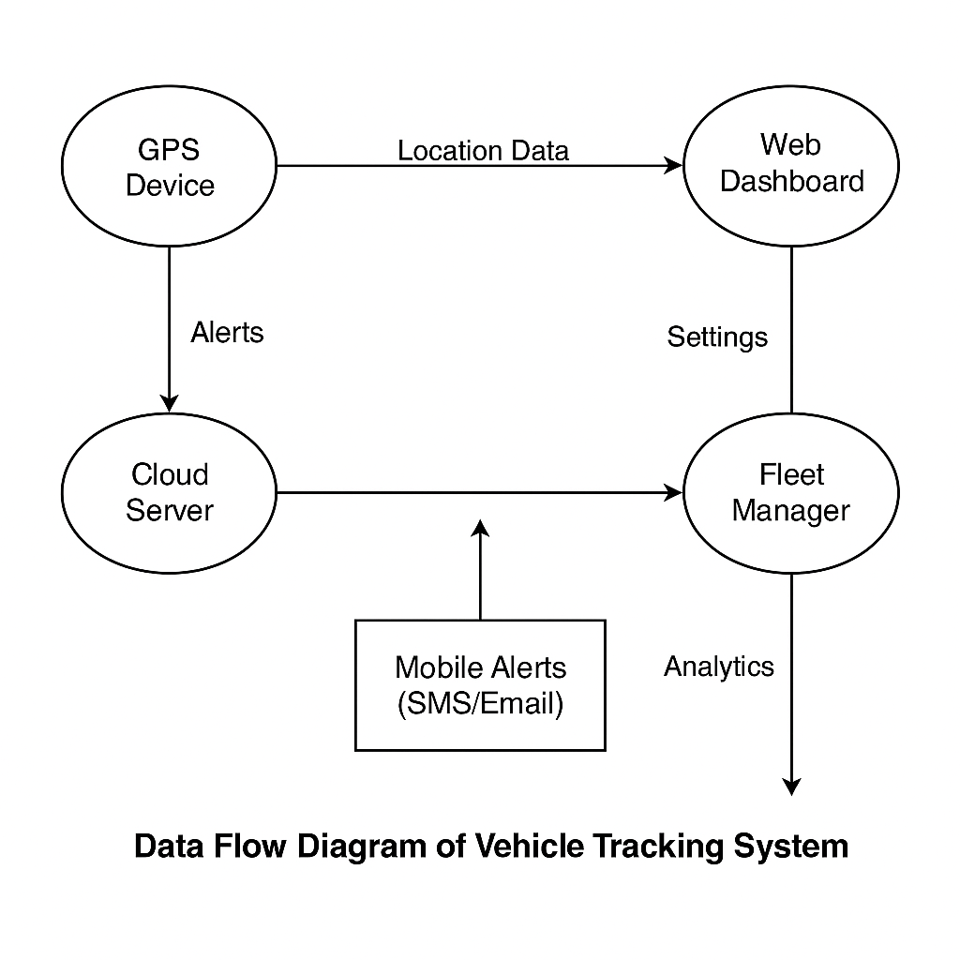
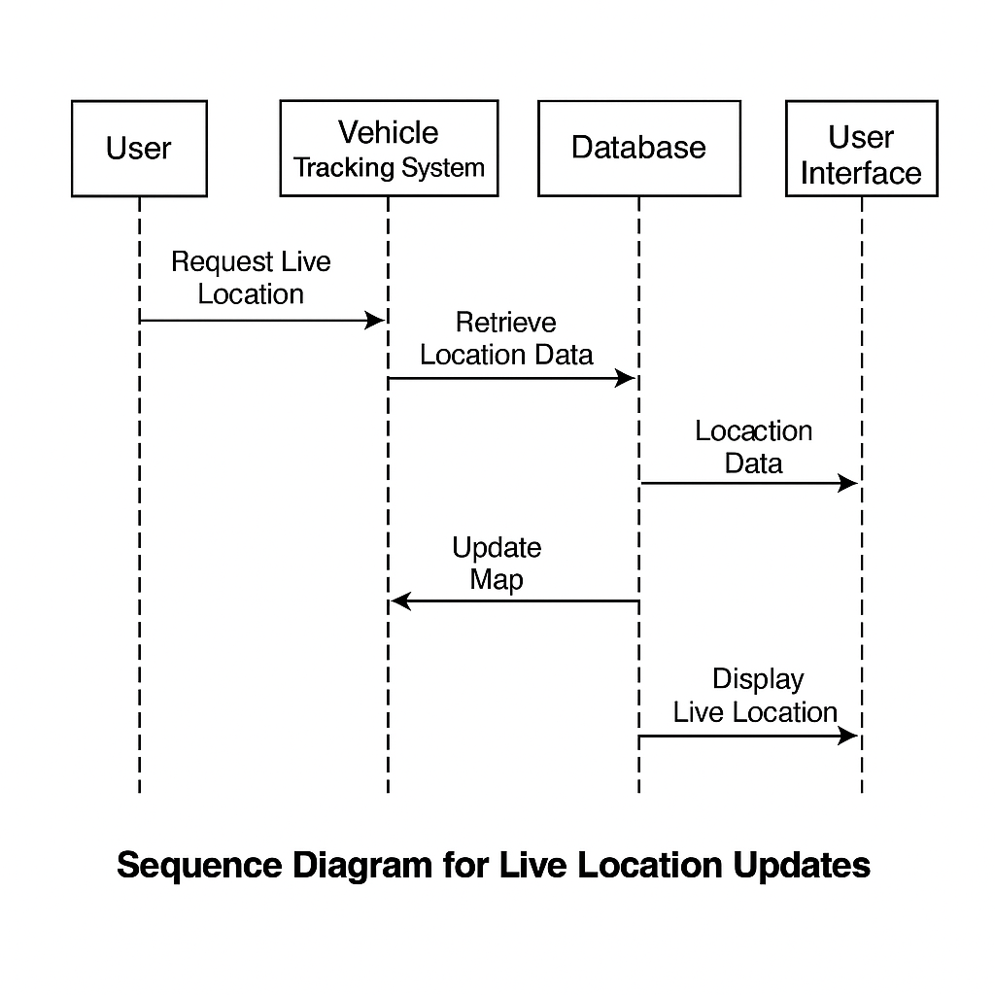
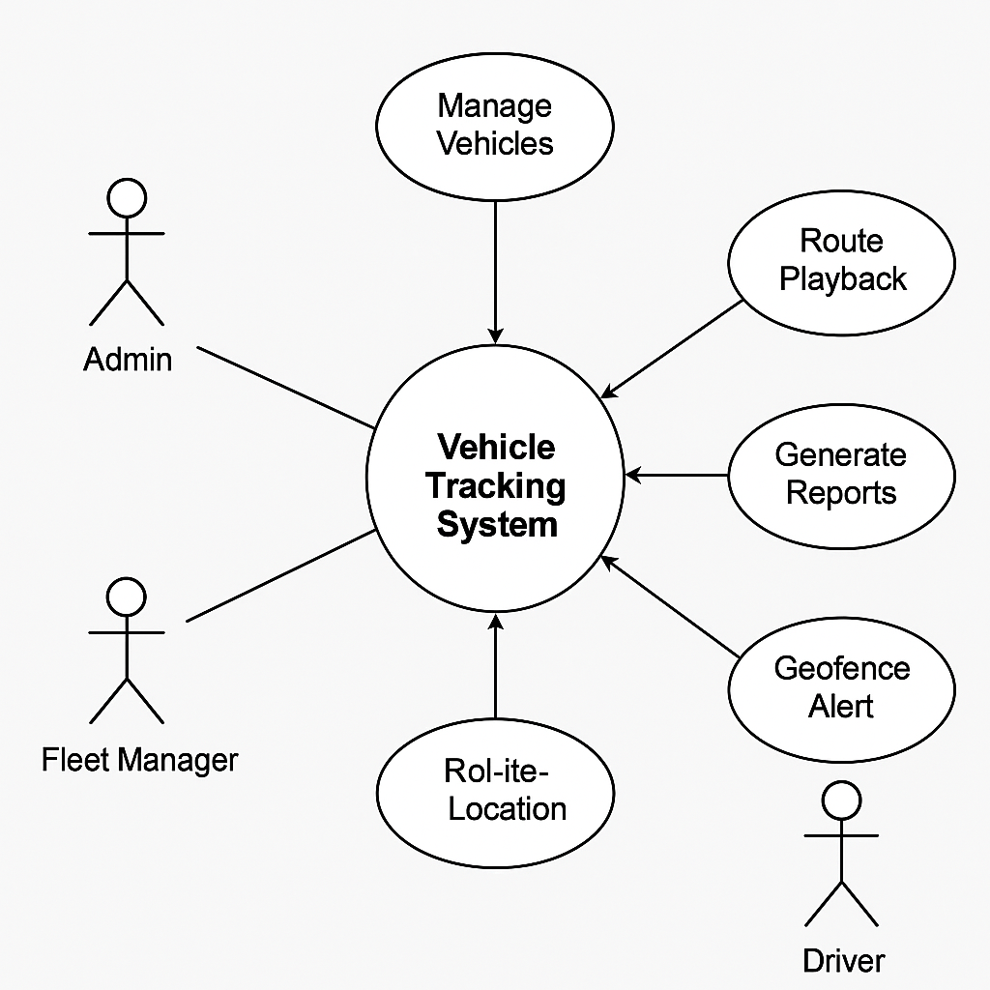
DATA FRMAE DIAGRAME FOR VTS LEVEL 1

Slide 11
System Features: Reporting and Analytics
Customizable Reports
Generate reports on mileage, fuel consumption, driver behavior.
Exception Reporting
Highlight speeding, idling, hard braking events.
Predictive Maintenance
Schedule maintenance based on vehicle usage and sensor data.
Reporting and analytics provide valuable insights into vehicle performance and driver behavior. Customizable reports allow users to generate specific reports based on their needs. Exception reporting highlights critical events, and predictive maintenance enables proactive maintenance scheduling. Driver performance scorecards provide a comprehensive evaluation of driver performance based on safety and efficiency metrics.

